Slide 1
Repeat Photography
Quantify the glacial erosion per year by comparing repeat photography photos
Jack Duggan, James Hughes and Ciaran O'Connor

Slide 2
The Plan
1. Find images
2. convert to colour space
3. Blur, sharpen, etc
4. Bitwise images
5. Quantify the difference.

Slide 3
The New Plan

Slide 4
Feature finding

Slide 5
Masking & morphology
Mask below 140
Open and close
Find contours
Mask contours

Slide 6
Overlaying Images
Show glacier
Adds white to mask
Draw on old image

Slide 7
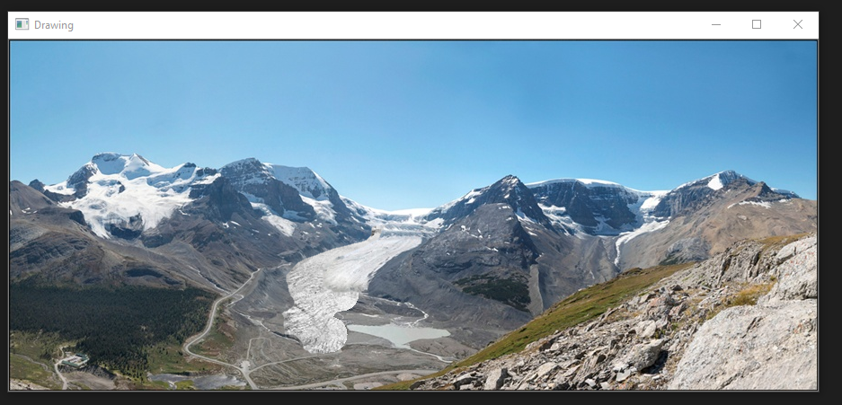
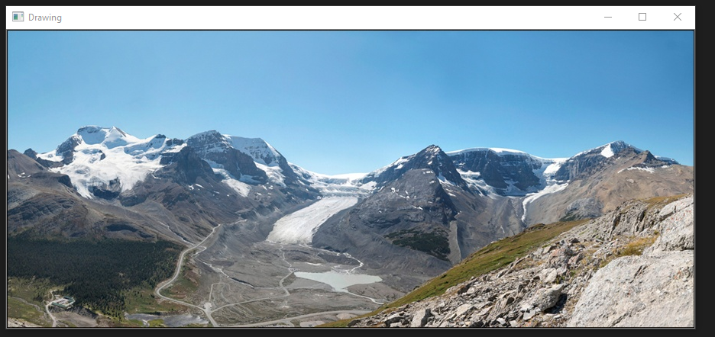
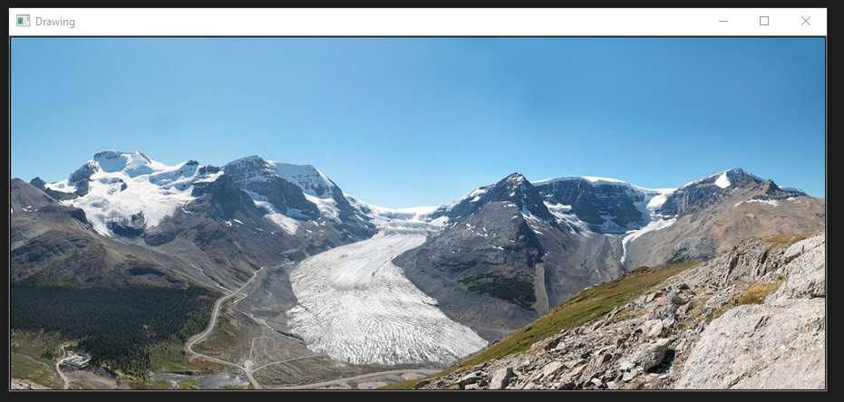
Outcome
During
Before
After

